Slide 1

Music Recommendation Service
Group 2: Jason Ingram & Isaiah Martinez
Notes:
1. Table of contents
2. Introduction
3. Quote
4. Study objectives
5. Literature review
6. Schedule
7. Methodology
8. Table
9. Results analysis
10. Conclusions
11. Bibliographical references

Slide 2
Table of contents
01
03
02
04
Project
Design
Data
Visualization
Web
Crawlers
Data Preparation

Slide 3
01
Project Design

Slide 4


Project Description
Music Recommendation Service:
2 Web Crawlers
2 User Data sources
Sources for User Data

Slide 5

Webcrawler Design
Snowball effect for Artists
Snowball Effect for genres

Slide 6
Project Design
User Data Music Data
Music Recommender
Combined
Dataset

Slide 7

02
Web Crawlers

Slide 8

Web Crawler Design
Isaiah
Music Map
Last.fm
Script
Holds Song Information
Obtains Related Artists to a given Artist
Stores data across several files

Slide 9
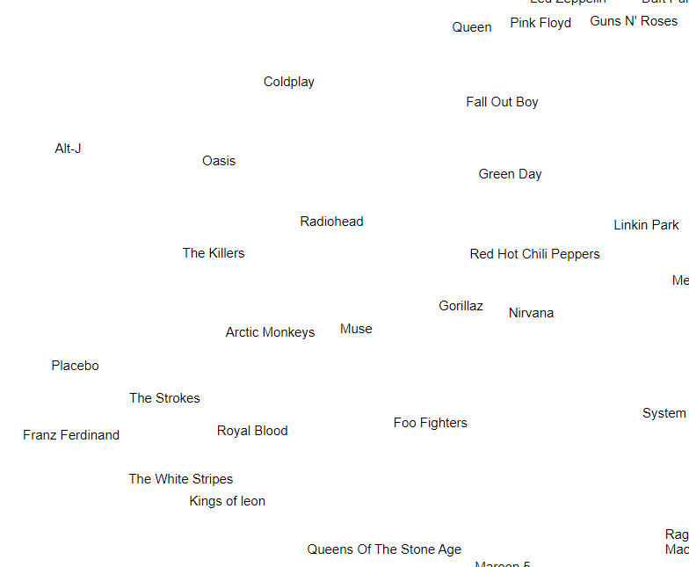
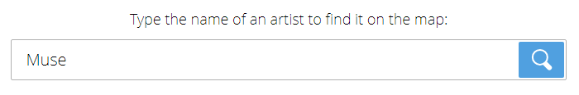
Music Map
Artist Name to search on music-map.com

Slide 10
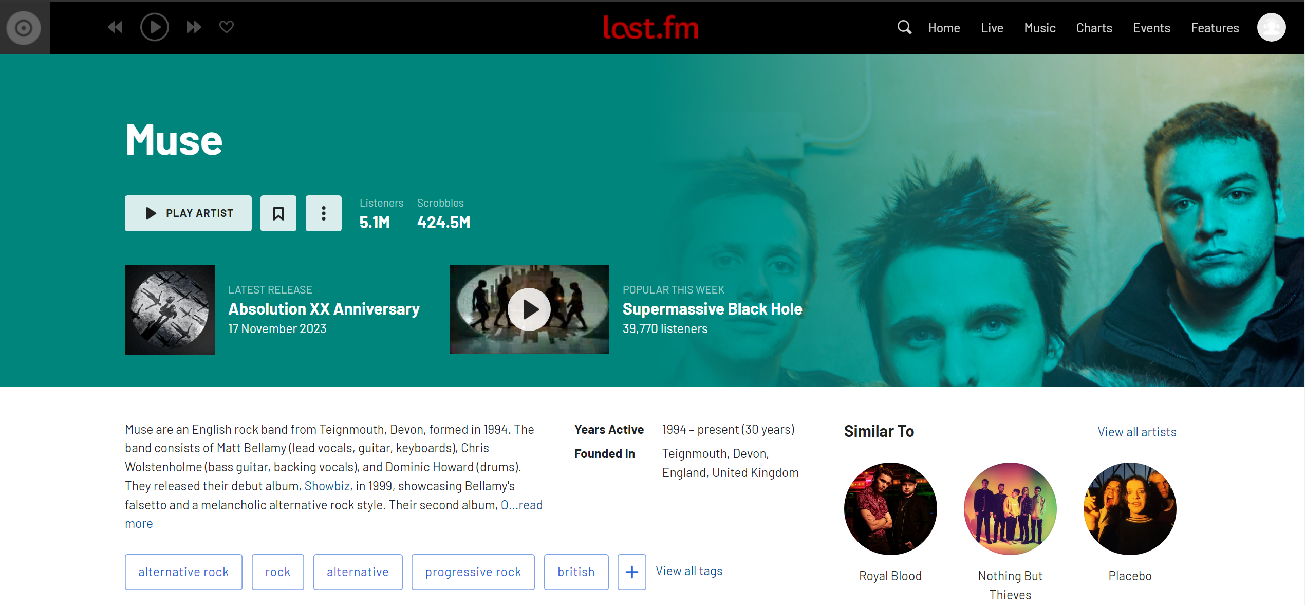
Last.fm
Artist page

Slide 11
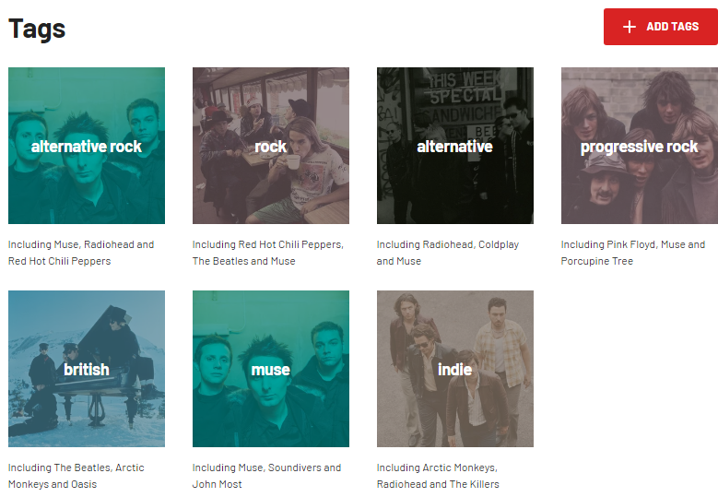
Last.fm
View all Artist Tags

Slide 12
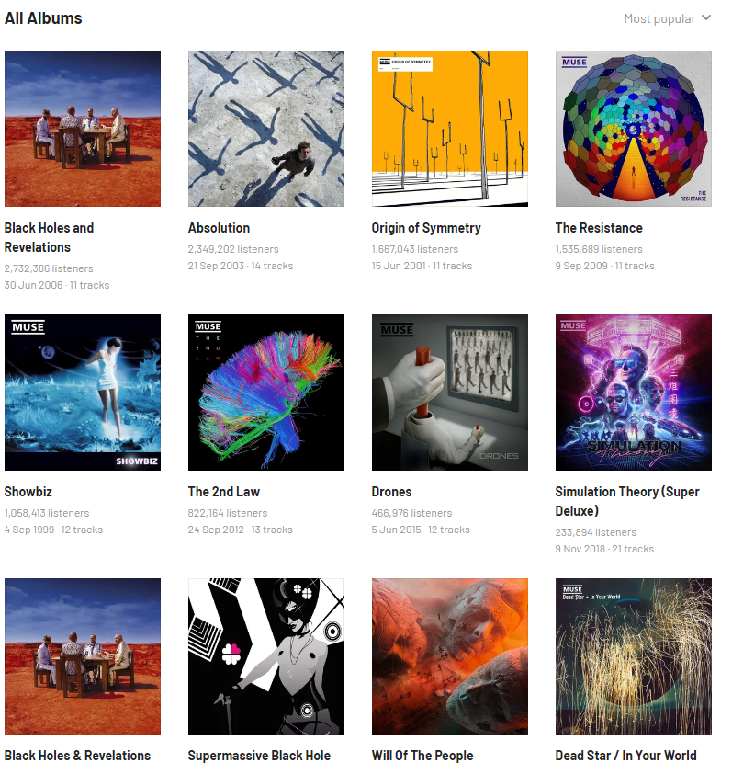
Last.fm
Collect all albums

Slide 13
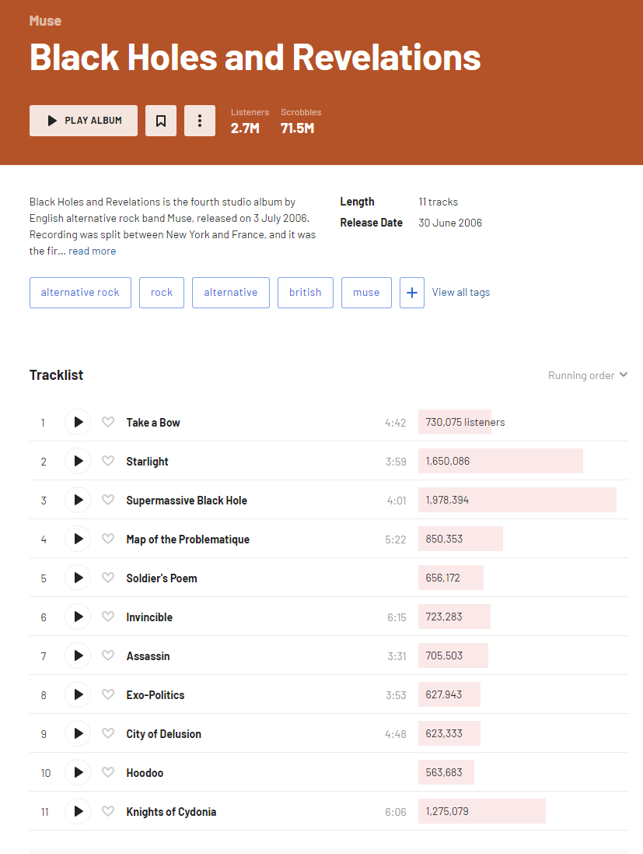
Last.fm
Desired information:
Album Name
Release Date
Album Tracklist

Slide 14
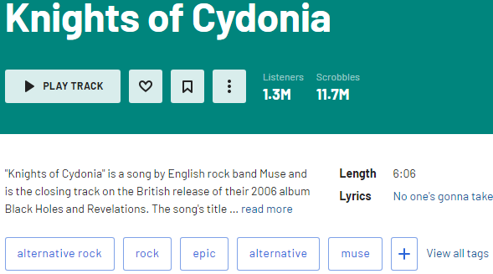
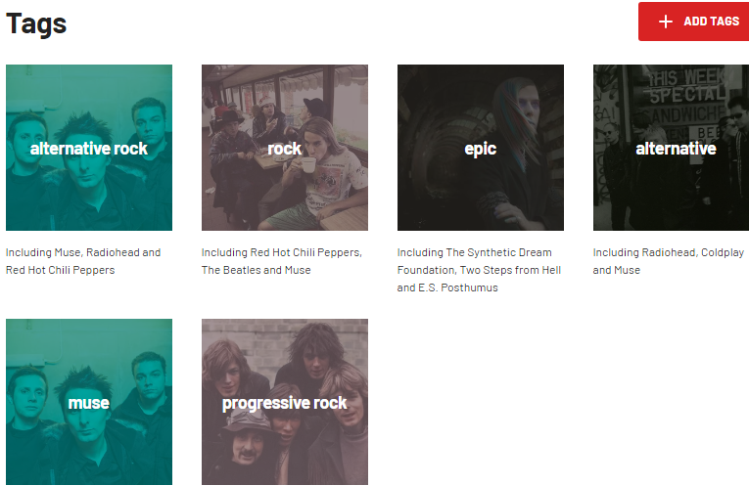
Last.fm
Song Length
Song Tags

Slide 15
Web Crawler Design
Jason
All Music
Script
Holds Genre and Song Information
Stores data into a csv

Slide 16
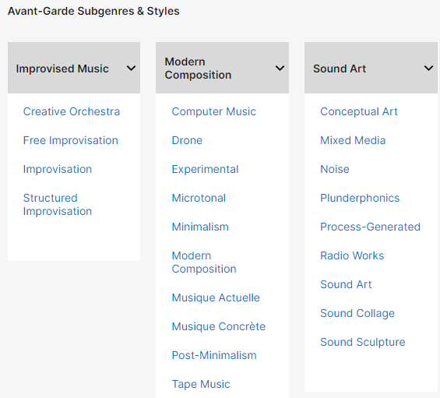
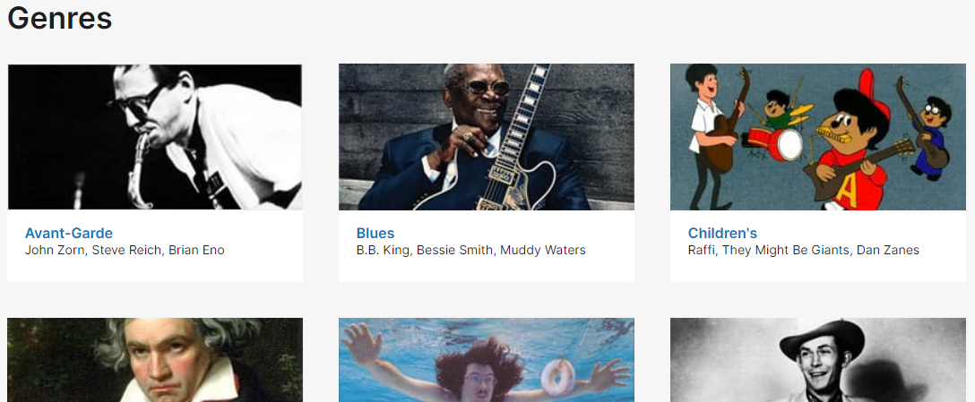
All Music
All Genres
All Sub-Genres

Slide 17
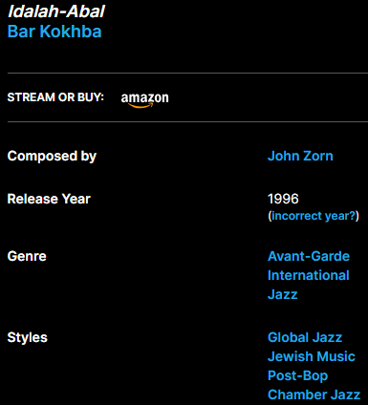
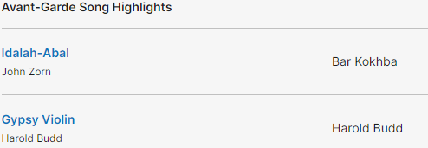
All Music
All Songs
Song Information

Slide 18
03
Data Visualization

Slide 19
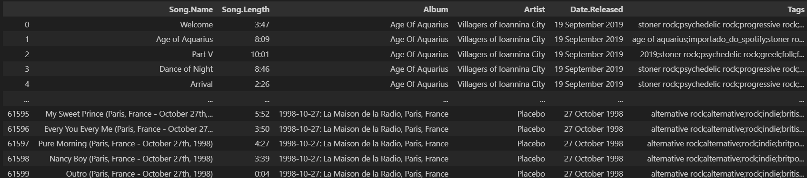
Dataset
CSV file

Slide 20
> 100,000
Total Songs with information*
Notes:
*At the time of making this ppt

Slide 21
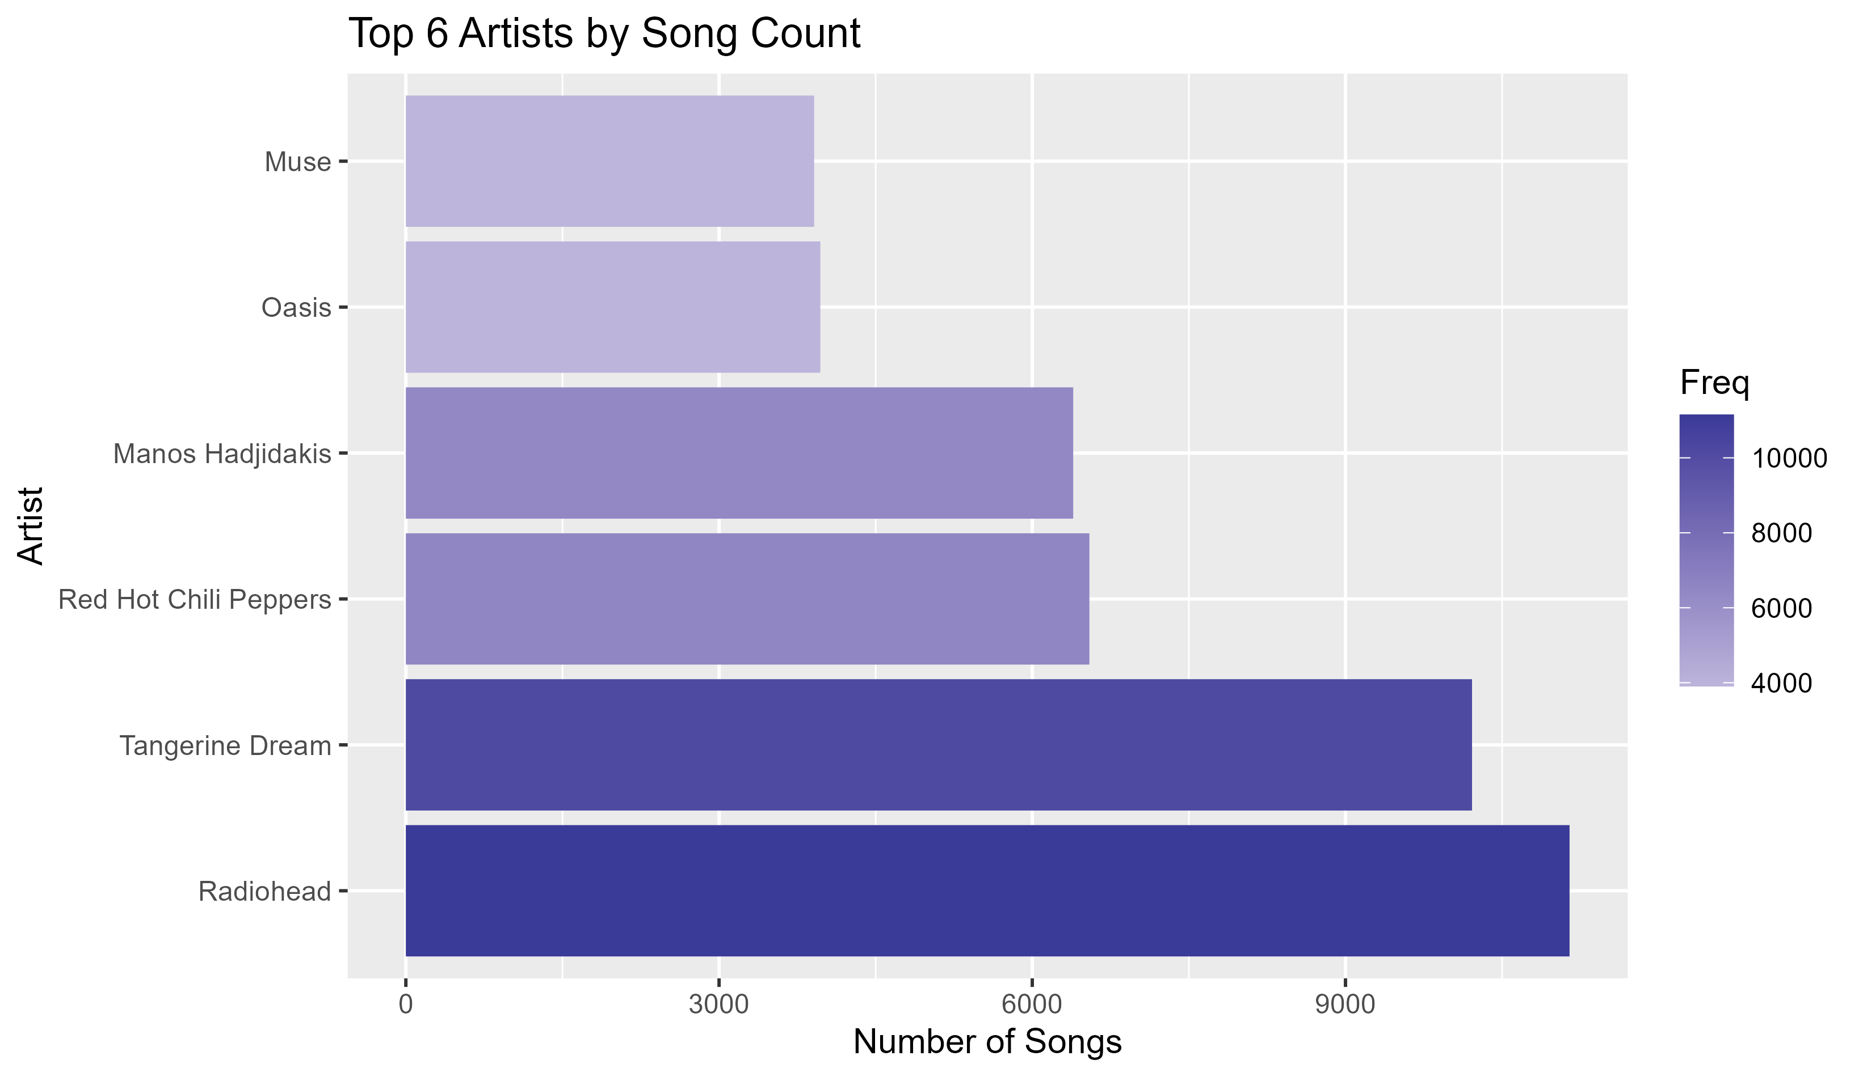
Top Artists by Song Count

Slide 22
04
Data Preparation

Slide 23

Data Cleaning
Merging of 3 different CSV files:
Laptop - Isaiah
PC - Isaiah
PC - Jason
Additional Steps:
Remove duplicate/redundant data
Obtain User Data
Non-genre tags

Slide 24

Questions?
Thanks for Listening

